Slide 1

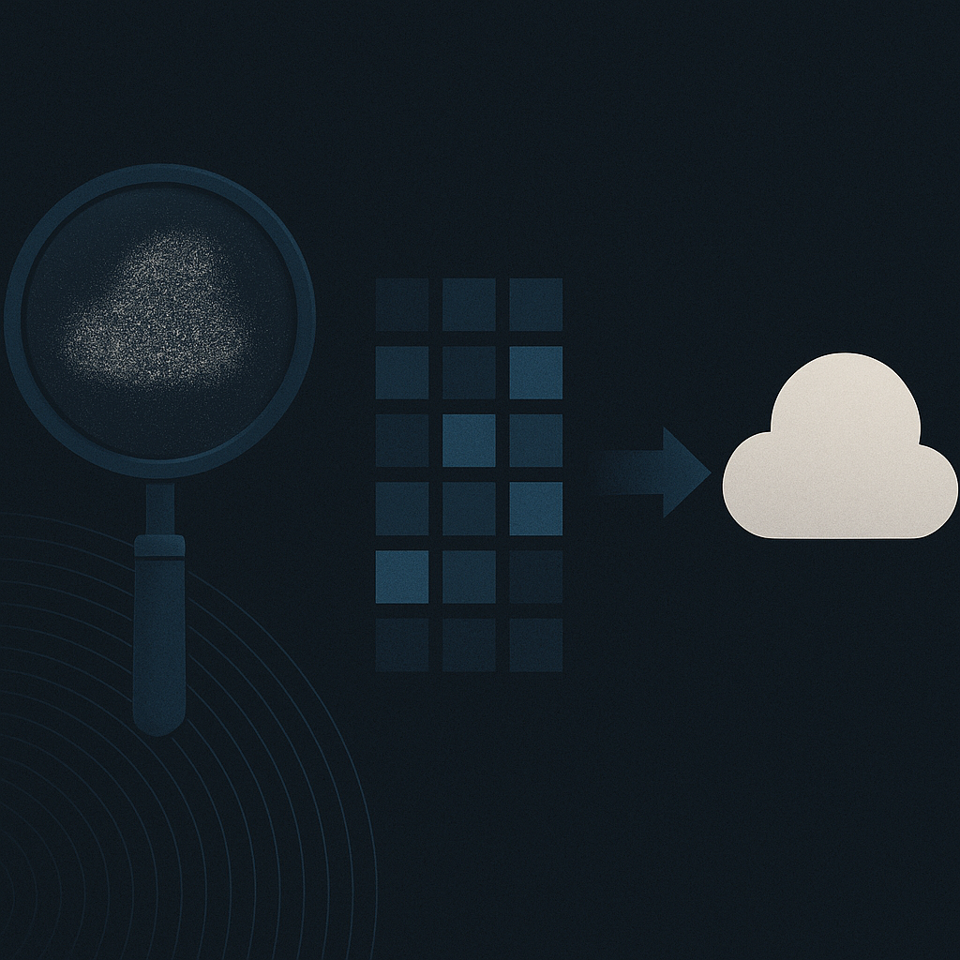
Introduction
What is image denoising?
Why is it important?
What are Convolutional Autoencoders (CAEs)?
Image Denoising

Slide 2

Motivation
Real-world relevance
Limitations of traditional methods
Why use deep learning (CAE)?
Why This Problem?

Slide 3

Methodology
Dataset & Preprocessing
CAE Architecture
Training Setup
Model Design & Workflow

Slide 4

Results & Conclusion
Quantitative Performance
Qualitative Insights
Conclusion
What We Achieved

Slide 5

Future Scope
Model Enhancements
Dataset Expansion
Application Potential
What Can Be Improved?

